Slide 1

International Islamic University Chittagong
Department Of Computer Science & Engineering
‘Wumpus World’
Presented by :
Team Binary Wing
Team Members:
Tehsim Fariha (C193207)
Raisa Ahmed (C193220)
Efter Jahan Ema (C193229)
Submitted to :
Subrina Akter
Assistant Professor
Dept. of Computer Science and Engineering
IIUC

Slide 2
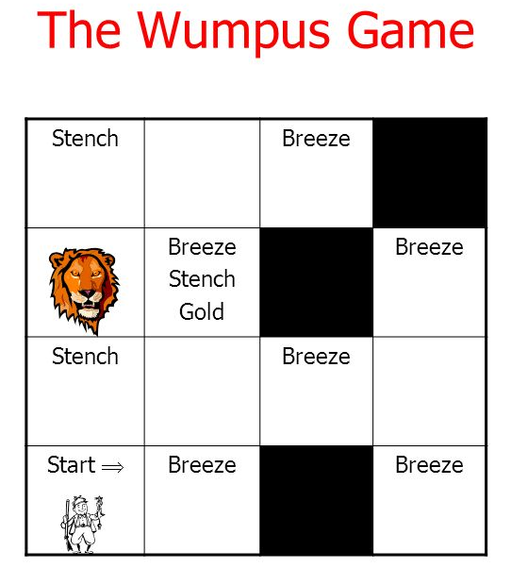
Introduction:

Slide 3
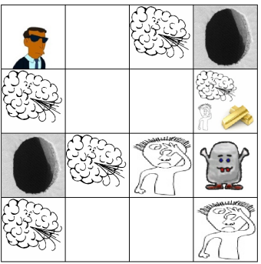
Problem Analysis:
Objects:
Agent
Wumpus
Gold
Pit
Breeze
Stench

Slide 4
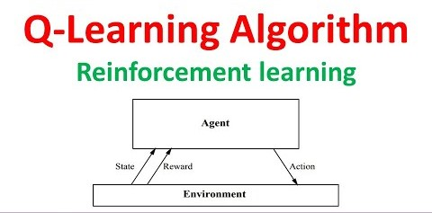
Design and Implementation:
Algorithm: Q-Learning Algorithm
Q-Learning Algorithm:
Q-Learning is a Reinforcement learning policy that will find the next best action, given a current state. It chooses this action at random and aims to maximize the reward.

Slide 5
Key Terminologies in Q-learning:
Agent
Environment
Action
Reward
Episode
Epsilon
Discount Factor
Learning Rate

Slide 6
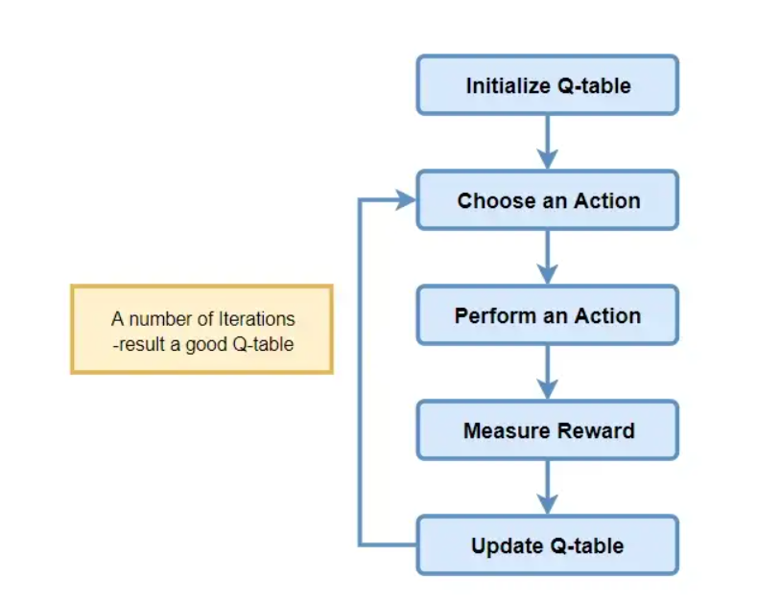
Q- Learning Algorithm process:

Slide 7
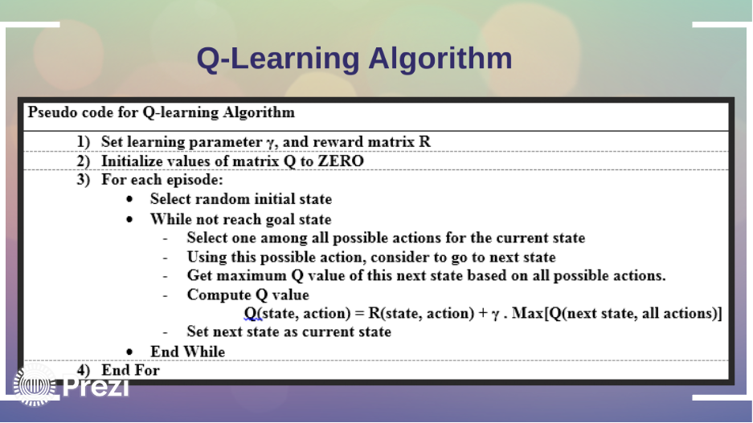
Q- Learning Pseudo code:

Slide 8
Q- Learning phases to solve Wumpus World problem:
Generate Wumpus world model and learning parameter
Initialize Q Matrix values
Build Reward Matrix
Training Session Phase
Termination Phase

Slide 9
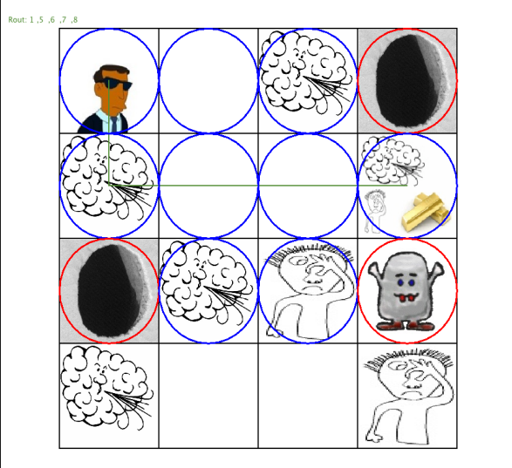
Results and Analysis
0 1 2 3
0
1
2
3
The path we got for hunting the Gold is : [0,0]-> [1,0]-> [1,1]-> [1,2]-> [1,3]

Slide 10
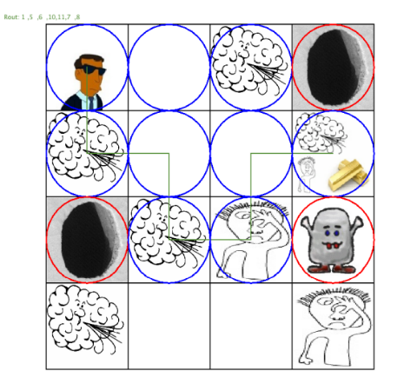
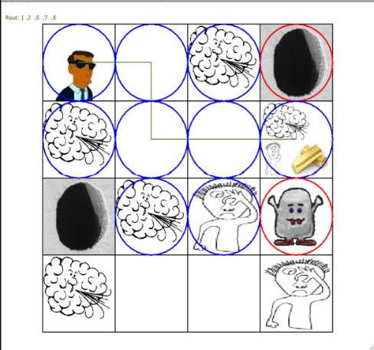
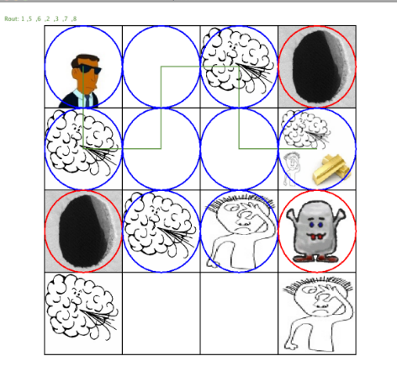
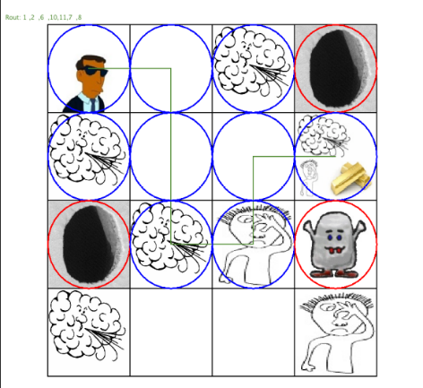
Other Possible Ways:
[0,0]-> [1,0]-> [1,1]-> [2,1]-> [2,2] -> [1,2] -> [1,3]
[0,0]-> [0,1]-> [1,1]-> [1,2] ]-> [1,3]
[0,0]-> [1,0]-> [1,1]-> [0,1]-> [0,2] -> [1,2] -> [1,3]
[0,0]-> [0,1]-> [1,1]-> [2,1]-> [2,2] -> [1,2] -> [1,3]

